Slide 1
The Capacity of Modern Computers
Yuan Ping
09/11/24

Slide 2
Outline
Moore’s law
Parallel computing
The fastest computers

Slide 3
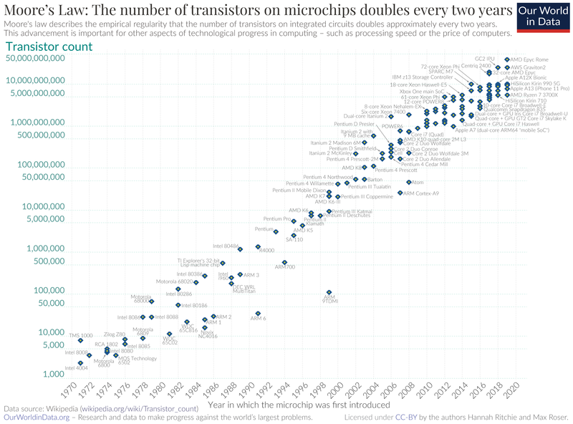
Moore’s Law: # Transistors Doubles ~ every 2 Years
S=S₀2^{(t/td)}, t_{d}=doubling time = 2 years (41 % compound annual growth rate)
Fast computers are central to atomistic modeling since it is very computationally intensive.
Posited in 1965, revised 1975.
https://en.wikipedia.org/wiki/Moore%27s_law

Slide 4
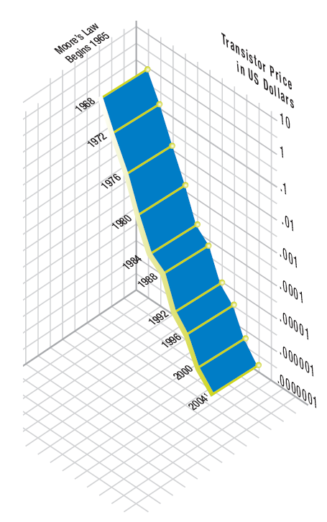
There is Also Associated Exponential Growth in Other Key Metrics
Moore’s Law for Price / Transistor
Exponential trends in: Processor speed, Price / transistor, Price / Floating Point OPeration (FLOP), disk storage / cm²
These are key to the general improvements of computing.
Moore’s law and other scalings are frequently expected to slow or end, But have not yet.
There are fundamental limits of how small a transistor can be and store charge, but could we have new technologies (e.g., quantum computing)?
Parallel computing a powerful tool for speedup
http://www.intel.com/museum/archives/history_docs/mooreslaw.htm

Slide 5
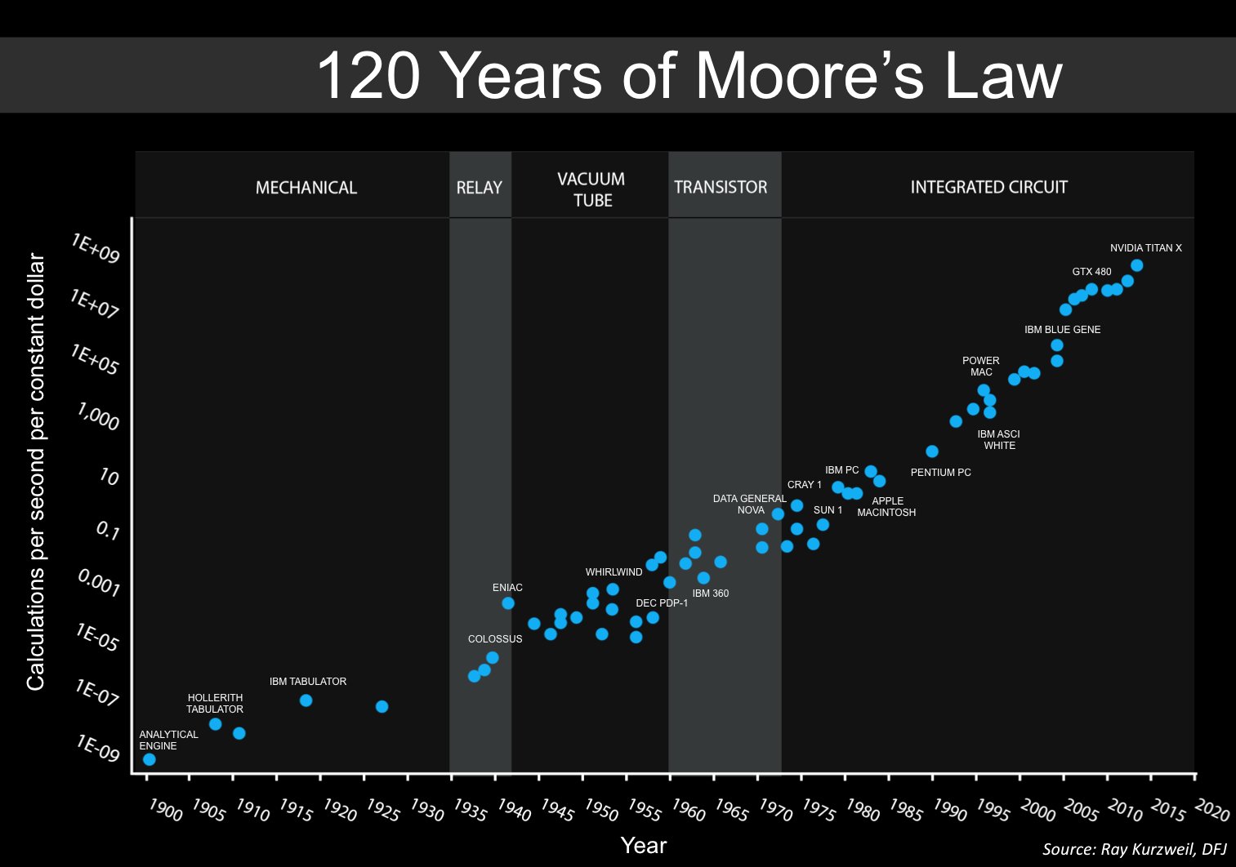
Extended Exponential Growth Curve for Calculation
By Steve Jurvetson - https://commons.wikimedia.org/w/index.php?curid=55002144, Based on Ray Kurzweil
For more musing on Moore’s law see http://en.wikipedia.org/wiki/Moores_law
In general probably good to assume we will have rapidly increasing computational capabilities in the next 10-20 years.

Slide 6
Parallel Computing
Parallel computing: Performing multiple calculations at the same time (in parallel) - uses more than one independent processor at a time.
Serial computing: Performing multiple calculations sequentially in time - uses one processor at a time.
Speedup S = Time(1 proc)/Time(N proc)
Ideal result: S=N ⇒ N processors makes your calculation take 1/N times as long (linear scaling)
Happens only for perfectly parallelizable algorithms
Lose time communicating between processors (queuing, routing, and sending data)
Some processes have to be serial and cannot be parallelized
Amdahl’s law says S = N/ [(f*N)+(1-f)] where f= fraction of algorithm that is serial
Many challenges are associated with efficient parallelization of molecular simulation problems

Slide 7
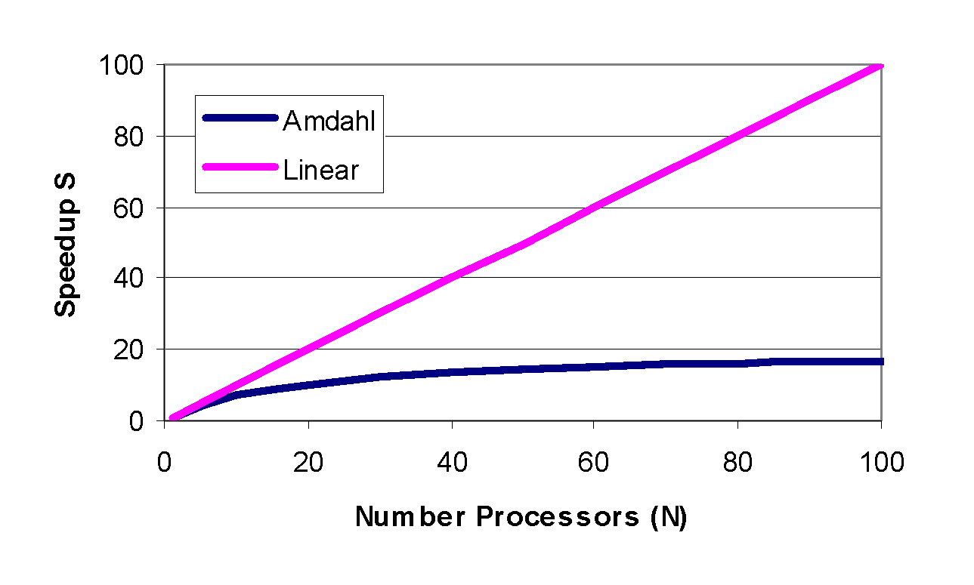
Parallel Computing: Amdahl’s Law
S = N/ [(f*N)+(1-f)]
F=0.05 (just 5% serial)
Massively parallel computing (e.g., on 100’s-1000’s of processors) requires almost no serial portion

Slide 8
The Speed of Modern Computers
Speed can be measured in many ways: integer operations, floating point (real number) operations (FLOPS), specific applications (Linpack benchmark),
ASUS Z170MPLUS motherboard (Intel Core i5-6600), 4 cores: max 91x10⁹ FLOPS = 91 GFLOPS (the SPEC benchmarks are at http://www.spec.org)
The fastest computers in the world are all parallel (use multiple processors), most (all?) are clusters of relatively standard PC processors connected together
The top 500 can be found at www.top500.org

Slide 9
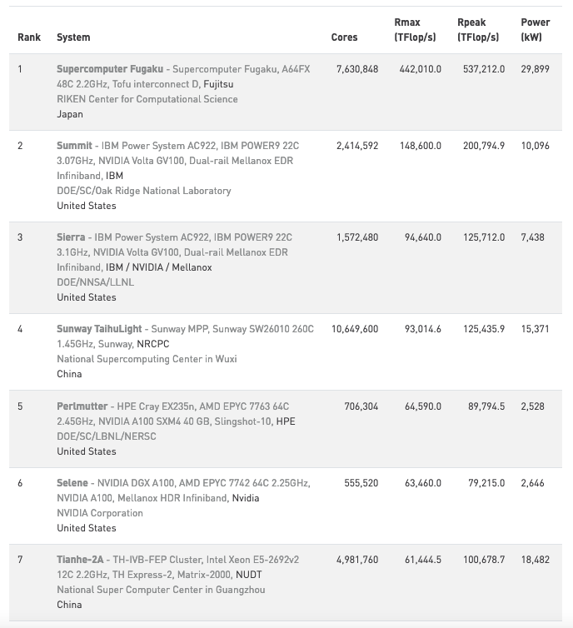
Fastest Computers: June 2021 http://www.top500.org
Calcs: ~5×10¹⁷ calcs/sec ≈ 10⁸ x Earth’s Population
Power: ~3×10⁵ 100W bulks ~ 120 cars @full power (250kw)

Slide 10
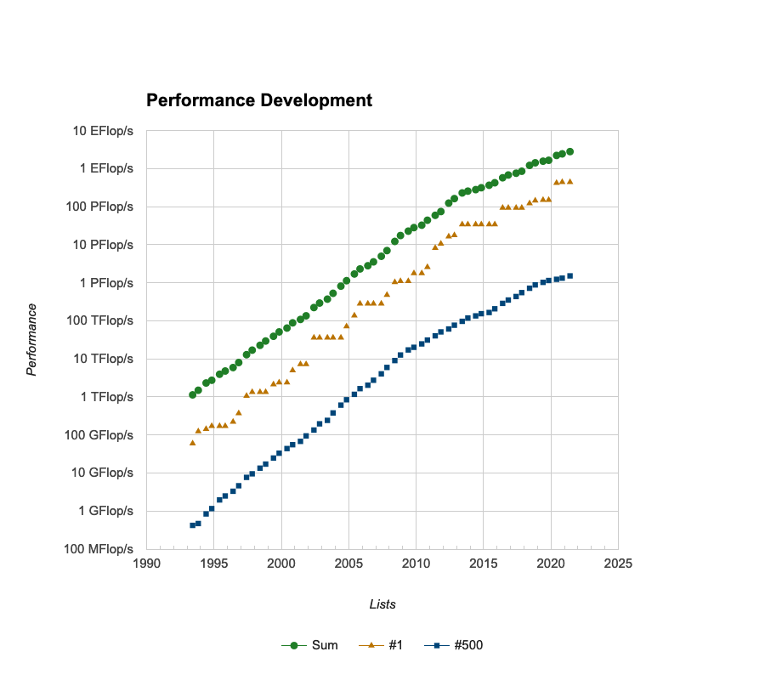
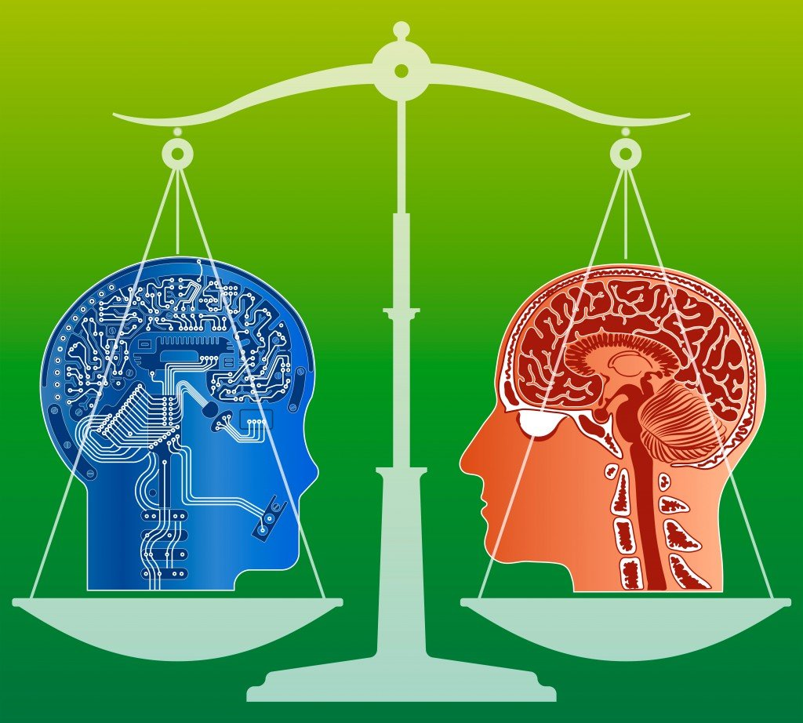

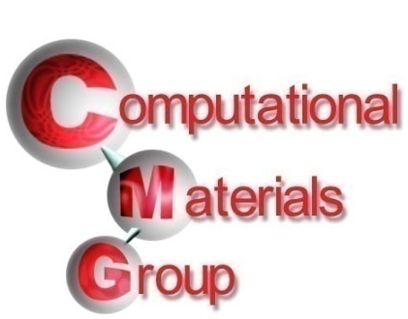
The Top 500: Performance
Note scaling S=S₀2^{(t/td)} ⇒ t_{d} = ~ 1.2 year doubling time. Faster than Moore’s law!!
The Brain
A laptop
Doubling ever 1.1 years!
100,000x in 20 years!

Slide 11
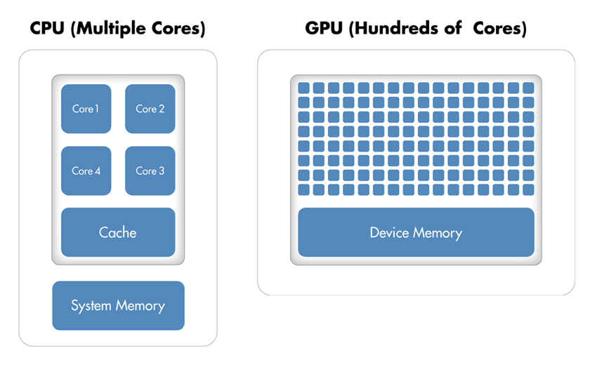
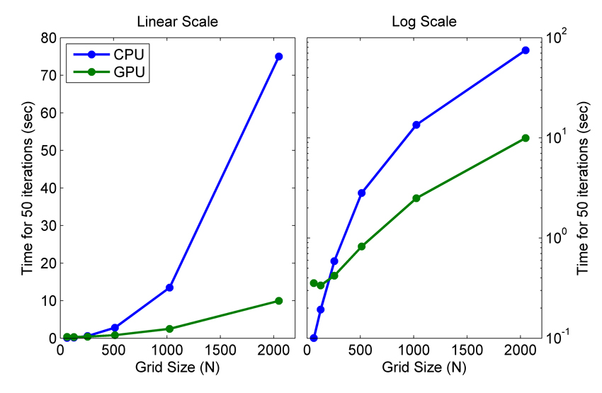
GPUs vs CPUs
CPU = Central Processor Unit.
This runs the computer and is quite general.
A few cores (~4-12) and runs a few “threads” (threads are separate parallel computations)
GPU = Graphical Processor Unit.
Traditionally just does graphical computations.
Hundreds of cores and thousands of threads, so good for very parallelizable calculations
Several programming environments, e.g, (Open Computing Environment (OpenCL) and Compute Unified Device Environment (CUDA)) allow general computing and coding to done on GPUs
They are increasingly being used for certain numerical tasks that are very parallel (many similar tasks being performed at the same time), e.g., Fast Fourier Transforms.
More technologies have recently arrived and likely expanding, e.g., Tensor Processing Units (For fast matrix operations), Neuromorphic chips, quantum computers.
http://www.mathworks.com/cmsimages/63256_wl_91967v00gpu_fig1_wl.jpg
GPU vs CPU for solving wave equations which use Fast Fourier Transforms

Slide 12
Summary
Computer figures of merit are generally doubling every 24 months (Moore’s law) for about the same cost
Fastest computers all make use of parallel computing (top speeds are now ~10¹⁷ FLOPS, see top500.org) and increasing of GPUs or other more specialized hardware (e.g., TPUs). Typical laptop is 100 GFLOPs.
Memory (RAM) on big machines, ~96-192 Gb, on your laptop ~32Gb – need to keep below this for practical use. 1Gb = 10⁹ element vector.
Massively parallel computing requires very efficient parallelization, as due GPUs (Amdahl’s law).

Slide 13
END

